Slide 1
CUSTOMER MANAGEMENT AND REVIEW MANAGEMENT
Team Members:
Mohan
Sai Prasad
Aravind
Sneha
Pravalika
Sindhuja
Pooja Nandana
Soumya
Notes:
Add instructor notes here.

Slide 2
OBJECTIVES
Project Understanding
Approach used
Project Execution
Modules
Learning
Best Practices
Opportunity for improvement
Notes:
Add instructor notes here.

Slide 3
PROJECT UNDERSTANDING
The main objective of this project is to design and develop Online BookStore System.
Online Bookstore contains abstract level of uses cases. Among those, we have design Customer Management and Review Management
Customer Management is used to manage customers(create customer account, update customer details, list of all customers and delete customer account).
Review Management is used to manage the reviews made by the customers(update a review, list of all reviews and delete a review).

Slide 4
High Level Design Diagram
Controller
User Interface
Controller
Service
Dao
Database

Slide 5
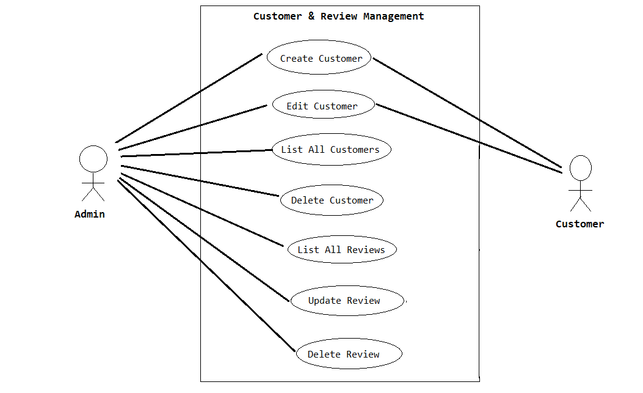
USE CASE DIAGRAM

Slide 6
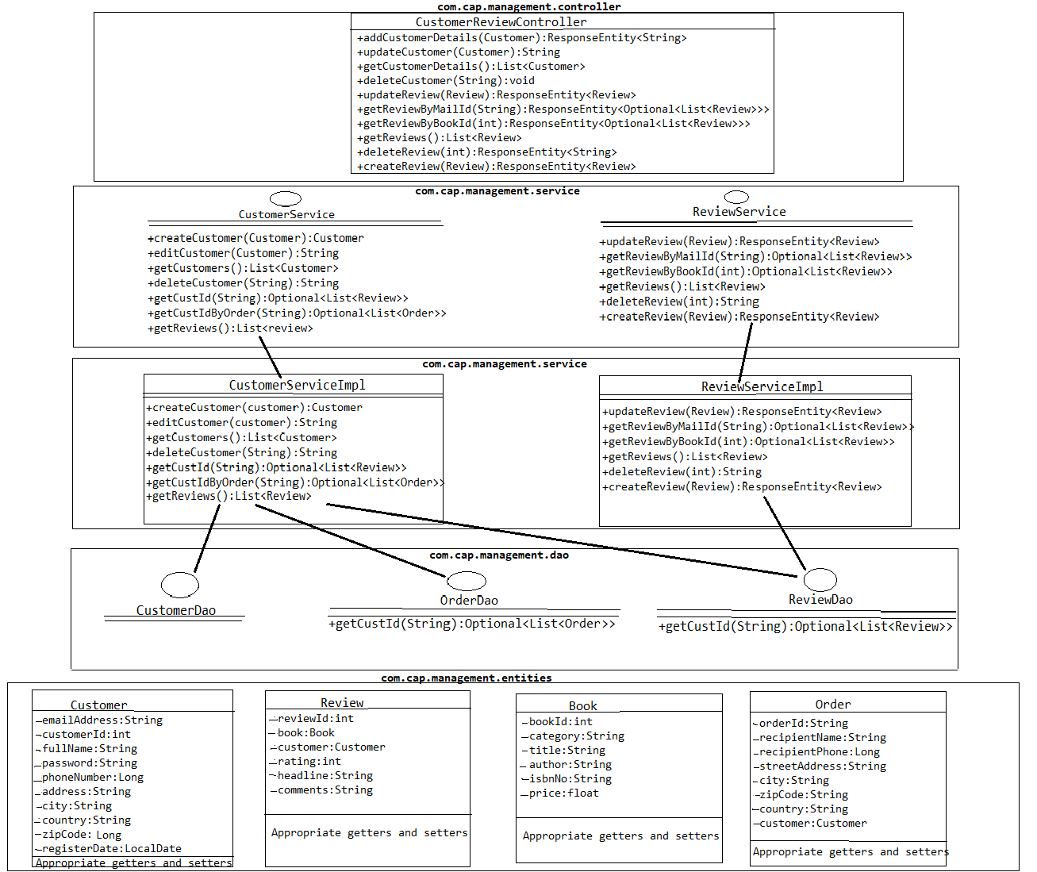
CLASS DIAGRAM

Slide 7
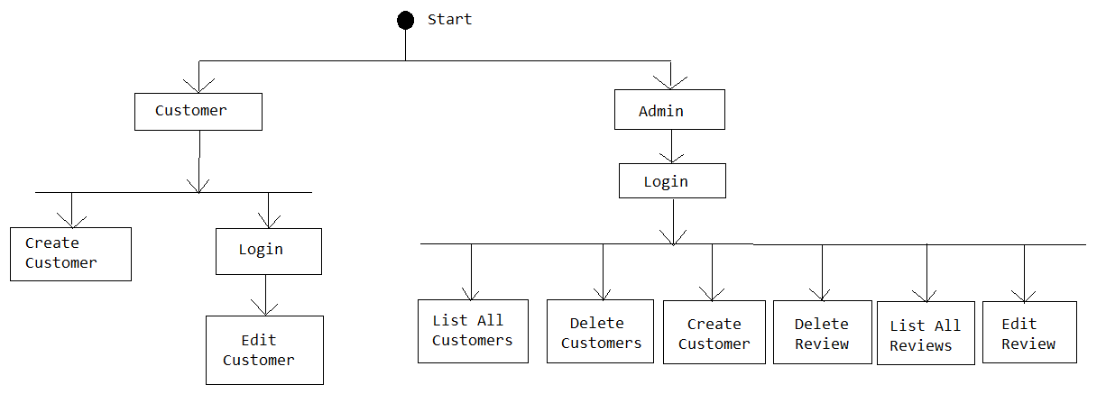
ACTIVITY DIAGRAM

Slide 8
APPROACH USED
Business Logic Components and Services :-
-Spring Boot
Databases:-
-Oracle SQL

Slide 9
PROJECT EXECUTION
Customer Module
Review Module

Slide 10
CUSTOMER MODULE
Admin can manage Customer functionality like create a customer account,edit customer details, list of all customers and delete customer account if there are no orders and reviews on any book.
Customers will be able to create a customer account and edit the customer details.

Slide 11
REVIEW MODULE
The Admin will be able to List all the reviews made by the customer, Update a review and delete a review if there are any violated reviews.

Slide 12
LEARNING
We have implemented the Customer Management and Review Management Usecases using Spring boot framework with JPA and Angular.
We have learned to work as a team.
Time Management and division of work.
Supporting team members in the work.

Slide 13
BEST PRACTICES
Followed placing comments in appropriate places
Followed naming conventions.
Followed proper indentation.

Slide 14
THANK YOU

